Slide 1




MOVIE STUDIO
INVESTMENT STRATEGY
Jeesoo Jhun
Flatiron Studio

Slide 2

OVERVIEW
Business Problem
Data Understanding
Key Findings
Recommendations
Next Steps

Slide 3




BUSINESS PROBLEM
Genres
Budget
Runtime

Slide 4


DATA UNDERSTANDING
Movie genres
Budgets
Revenues
Runtime
Ratings

Slide 5
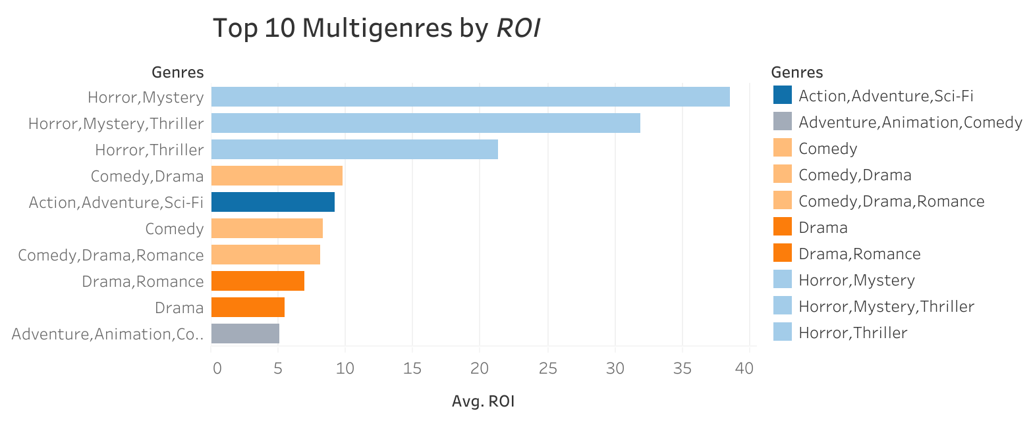
Which Genres Are Most Profitable (ROI)?
Horror, Mystery, Thriller

Slide 6
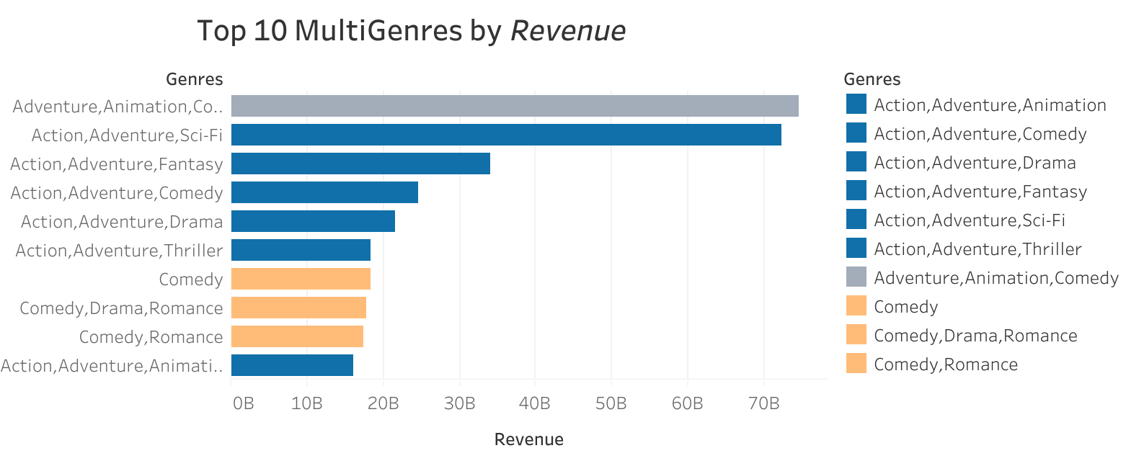
Which Genres Are Most Profitable (Revenue)?
Adventure, Action

Slide 7
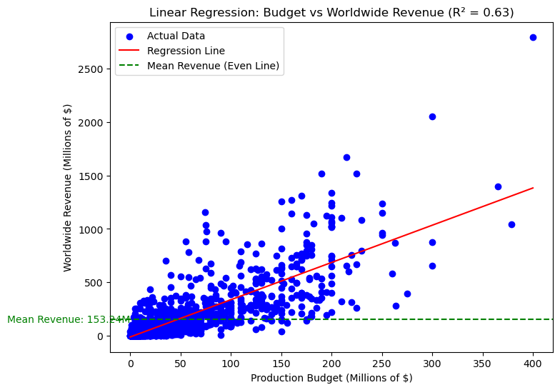
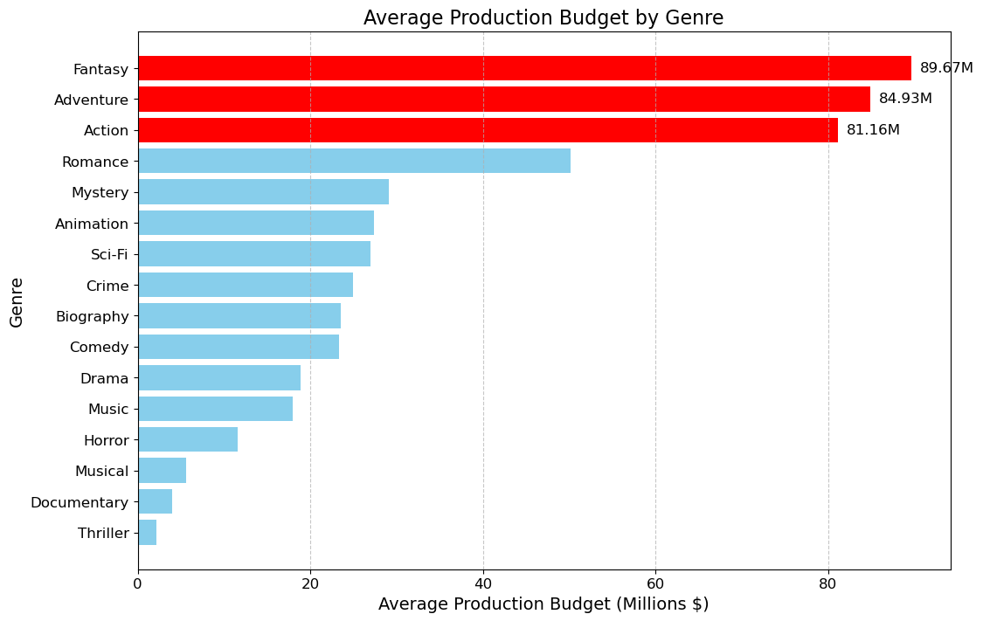
How Do Production Budgets Impact Success?
Production budgets ↑
→ Revenue ↑

Slide 8
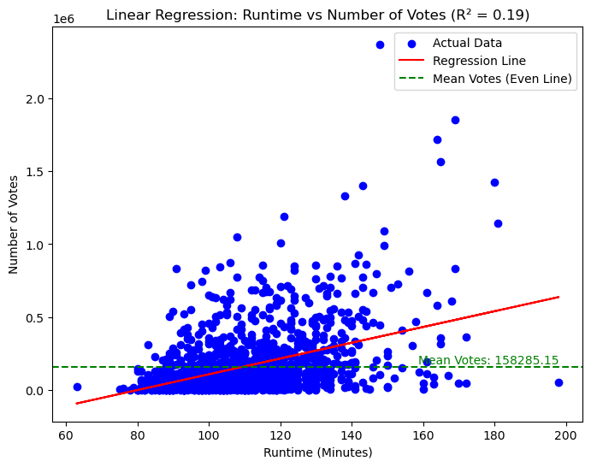
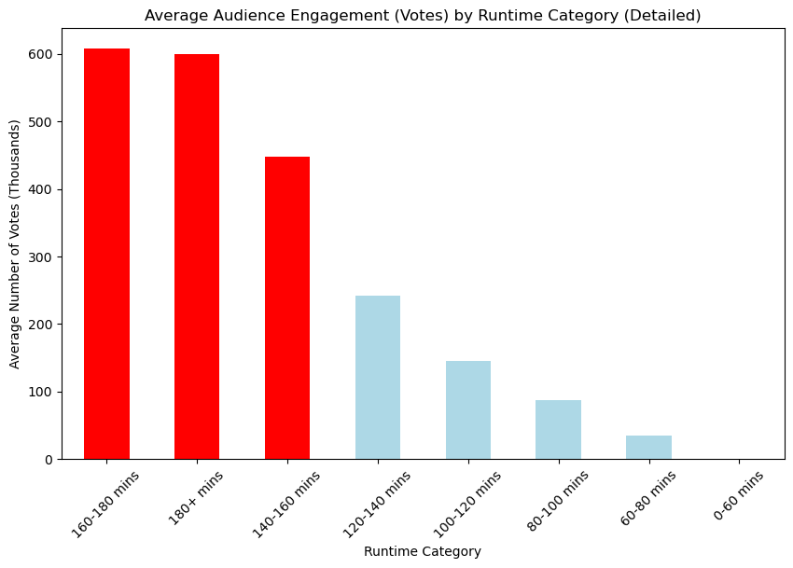
How Does Runtime Affect Success and Engagement?

Slide 9
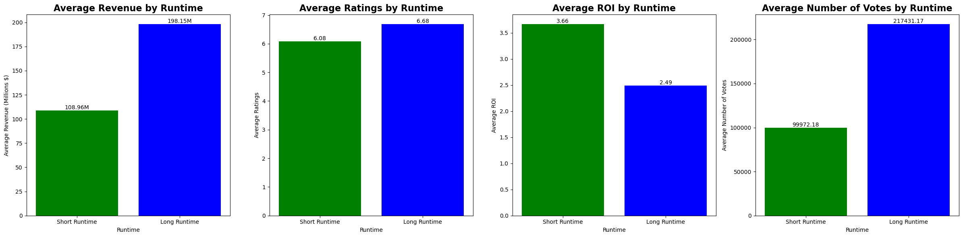
Short Runtime (<106min) vs Long Runtime (>106 min)

Slide 10




RECOMMENDATIONS
Horror, Mystery, Thriller
<$20M
High ROI, 25%
Comedy, Drama, Romance
$40M ~ $70M
Balanced Risk, 35%
Action, Adventure, Fantasy
$80M +
High Engagement, 40%

Slide 11



NEXT STEPS

Slide 12




THANK YOU
jeesoo@flatiron.com

